Slide 1

7th Grade Math
Unit 10, Lesson 2 Solving One-Step Inequalities Using Addition and Subtraction Volume 2, pg. 91

Slide 2


Benchmark
MA.7.AR.2.1
Write and solve one-step inequalities in one variable within a mathematical context and represent solutions algebraically or graphically.
volume 2, pg. 91

Slide 3
Integrated Mathematical Thinking and Reasoning Standards
MA.K12.MTR.1.1 Actively participate in effortful learning both individually and collectively.
MA.K12.MTR.2.1 Demonstrate understanding by representing problems in multiple ways.
MA.K12.MTR.4.1 Engage in discussions that reflect on the mathematical thinking of self and others.
MA.K12.MTR.5.1 Use patterns and structure to help understand and connect mathematical concepts.
volume 2, pg. 91

Slide 4

Learning Targets
I can solve one-step inequalities in one variable using addition or subtraction.
I can relate properties of inequality to solving one-step inequalities algebraically.
volume 2, pg. 91

Slide 5

Warm-Up
volume 2, pg. 92

Slide 6
10.2.1 Warm-Up: Cost Estimators
Cost estimators use data analytics to estimate the cost of manufacturing a product, constructing a building, or providing a service. They predict the amount of time, money, materials, and labor that will be needed to complete a project. This includes factoring in variables that may arise during the course of a project such as bad weather or shipping delays.
How do you think cost estimators use the minimum and maximum values of inequalities in their work?
Cost estimators usually specialize in a particular product or industry. Why do you think this is helpful?
volume 2, pg. 92

Slide 7

Exploration
volume 2, pg. 92

Slide 8


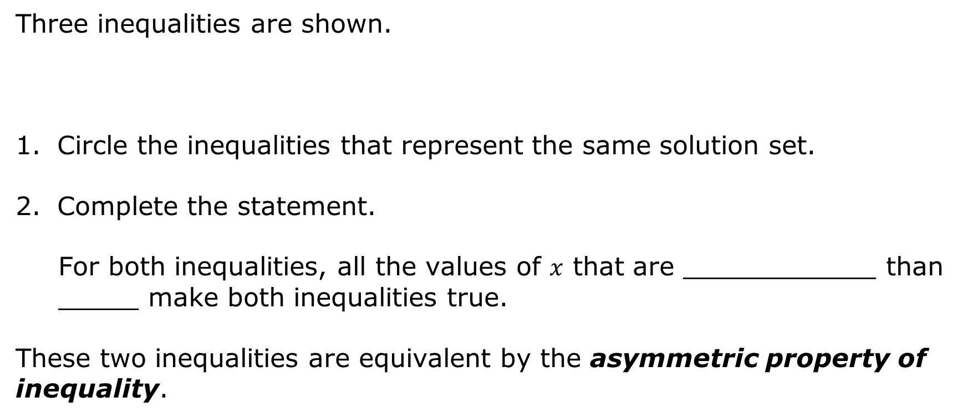
10.2.2 Exploration: Properties of Inequality
Three inequalities are shown.
Circle the inequalities that represent the same solution set.
Complete the statement.
For both inequalities, all the values of $x$ that are ____________ than _____ make both inequalities true.
These two inequalities are equivalent by the asymmetric property of inequality.
$$x>{}_{}^{−}{2.3}$$ | $${}_{}^{−}{2.3}>x$$ | $${}_{}^{−}{2.3}<x$$
volume 2, pg. 92

Slide 9


The asymmetric property of inequality states that if $a>b$, then $b<a$.
Use the asymmetric property of inequality to write an inequality equivalent to $q+\frac{2}{5} ≤ \frac{7}{10}$.
volume 2, pg. 92

Slide 10
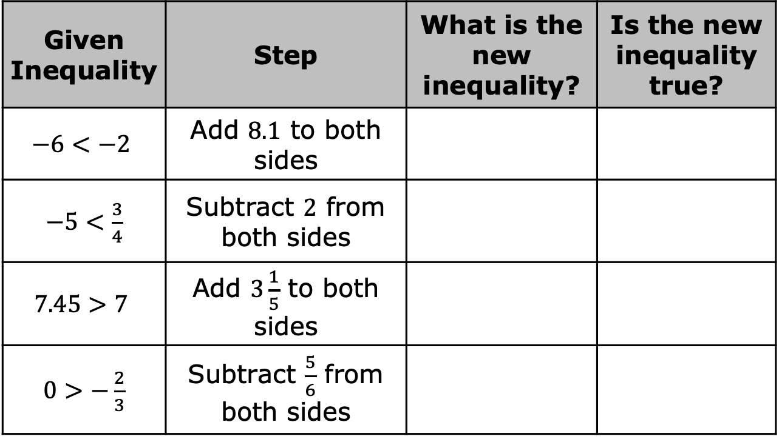
Four true inequalities are given in the table. Work with your partner to complete the table by following the steps indicated for each inequality and then answering the questions.
Given Inequality | Step | What is the new inequality? | Is the new inequality true?
$$−6<−2$$ | Add $8.1$ to both sides
$−5<\frac{3}{4}$ | Subtract $2$ from both sides
$$7.45>7$$ | Add $3\frac{1}{5}$ to both sides
$0>−\frac{2}{3}$ | Subtract $\frac{5}{6}$ from both sides
volume 2, pg. 93

Slide 11
Use your work on the previous problem to complete the description of each property.
Property of Inequality | Description
Addition property of inequality | When the same value is added to both sides of a true inequality, …
Subtraction property of inequality | When the same value is subtracted from both sides of a true inequality, …
volume 2, pg. 93

Slide 12

Guided Instruction
volume 2, pg. 93

Slide 13
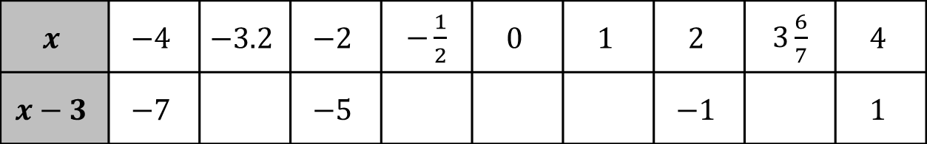
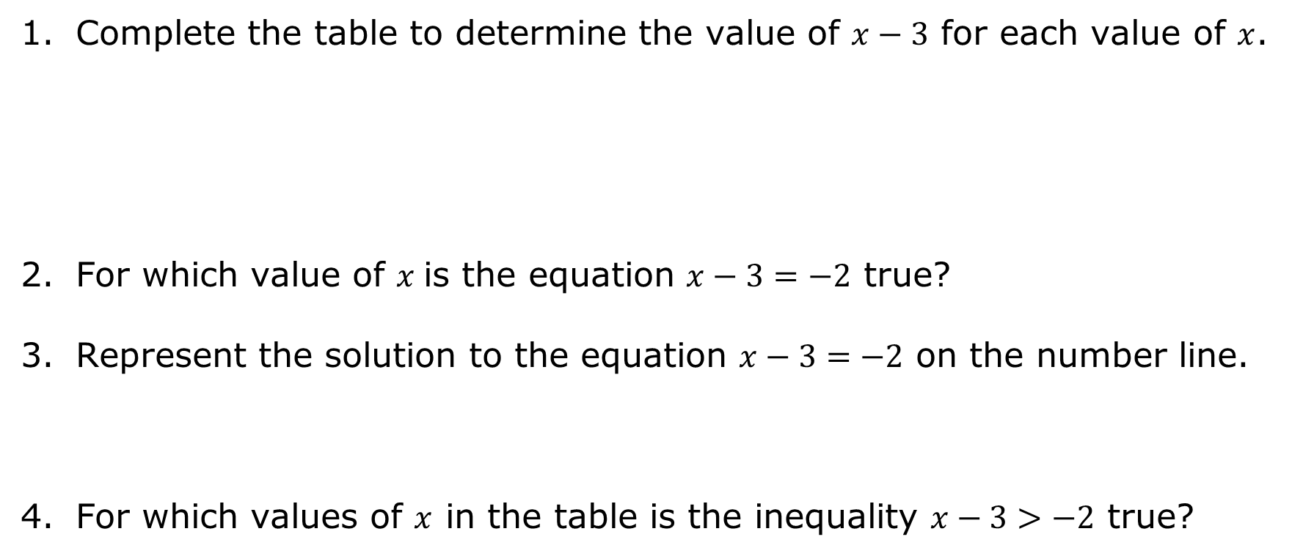
10.2.3 Guided Instruction: Solving One-Step Inequalities with Addition and Subtraction
Complete the table to determine the value of $x−3$ for each value of $x$.
For which value of $x$ is the equation $x−3=−2$ true?
Represent the solution to the equation $x−3=−2$ on the number line.
For which values of $x$ in the table is the inequality $x−3>−2$ true?
$$x$$ | $$−4$$ | $$−3.2$$ | $$−2$$ | $−\frac{1}{2}$ | $$0$$ | $$1$$ | $$2$$ | $3\frac{6}{7}$ | $$4$$
$$x−3$$ | $$−7$$ |  | $$−5$$ |  |  |  | $$−1$$ |  | $$1$$
volume 2, pg. 93

Slide 14
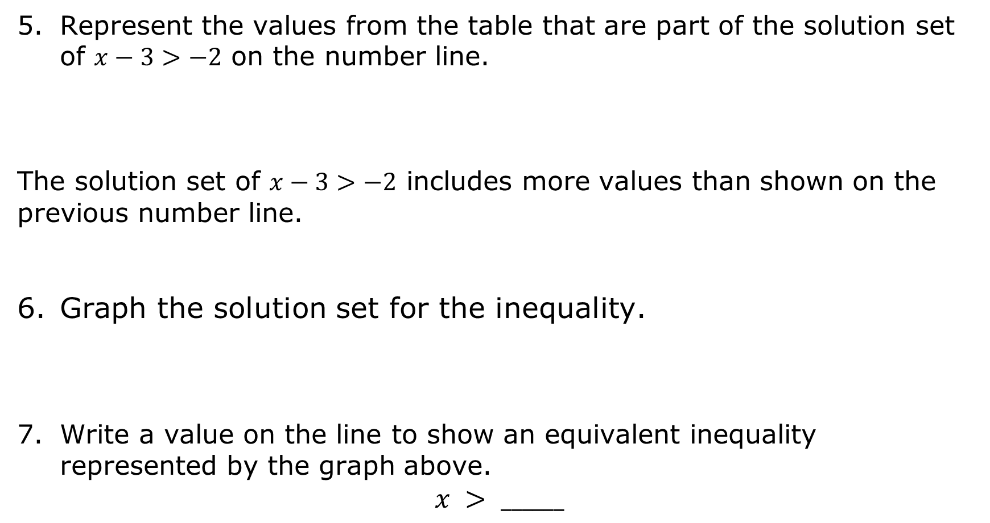
Represent the values from the table that are part of the solution set of $x−3>−2$ on the number line.
The solution set of $x−3>−2$ includes more values than shown on the previous number line.
Graph the solution set for the inequality.
Write a value on the line to show an equivalent inequality represented by the graph above.
$$x > ______$$
volume 2, pg. 94

Slide 15
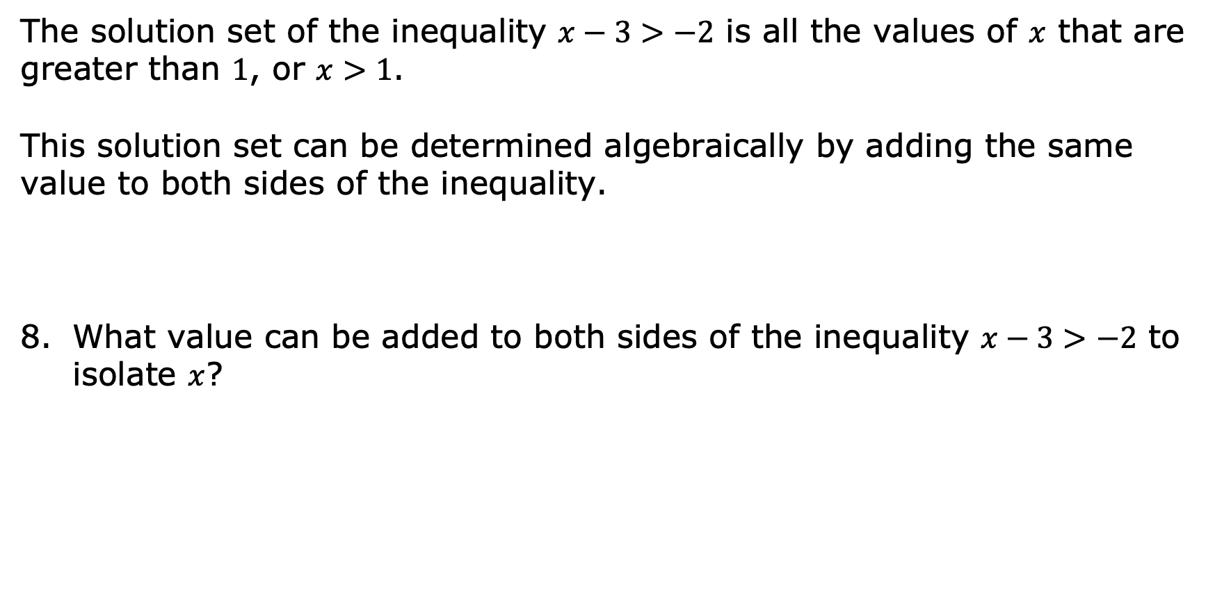
The solution set of the inequality $x−3>−2$ is all the values of $x$ that are greater than $1$, or $x>1$.
This solution set can be determined algebraically by adding the same value to both sides of the inequality.
What value can be added to both sides of the inequality $x−3>−2$ to isolate $x$?
volume 2, pg. 94

Slide 16

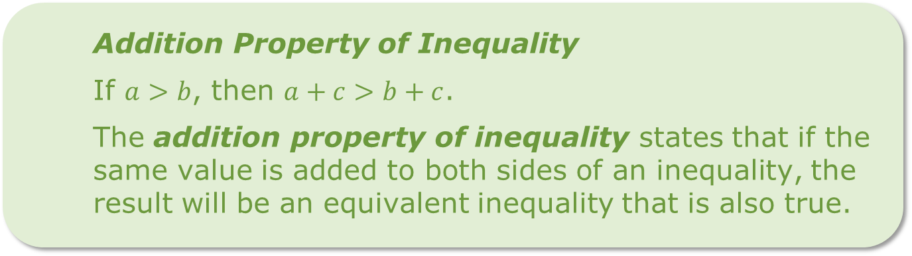
Adding the same value to both sides of an inequality can be used to solve an inequality by the addition property of inequality.
Addition Property of Inequality
If $a>b$, then $a+c>b+c$.
The addition property of inequality states that if the same value is added to both sides of an inequality, the result will be an equivalent inequality that is also true.
volume 2, pg. 94

Slide 17
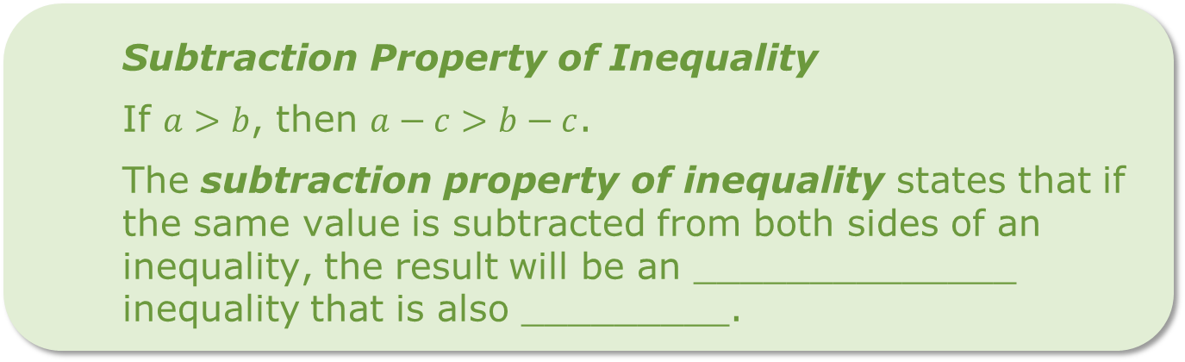
The subtraction property of inequality can also be used to solve an inequality.
Subtraction Property of Inequality
If $a>b$, then $a−c>b−c$.
The subtraction property of inequality states that if the same value is subtracted from both sides of an inequality, the result will be an ______________ inequality that is also _________.
volume 2, pg. 94

Slide 18
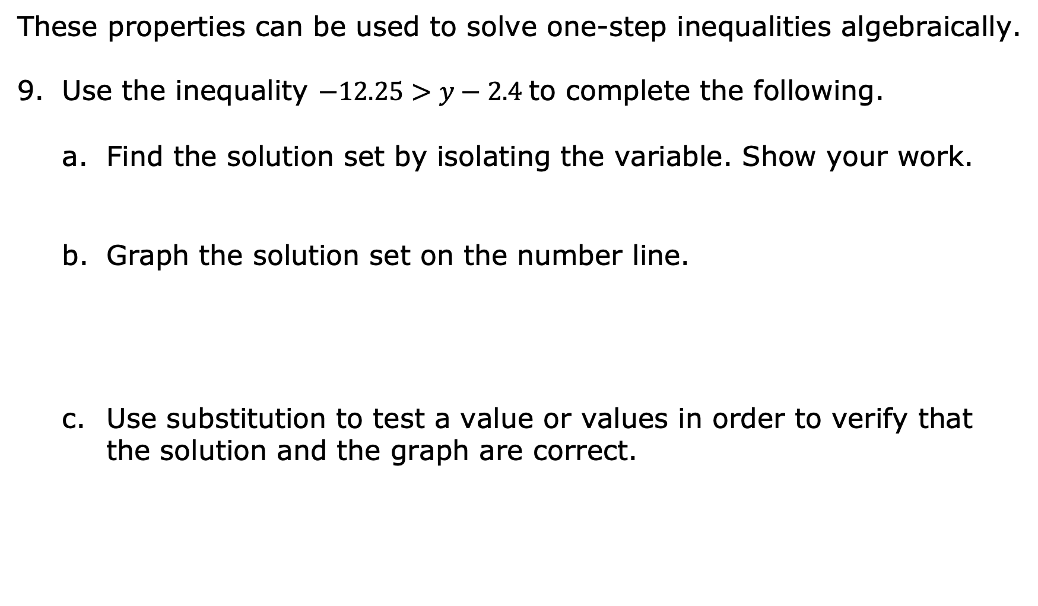
These properties can be used to solve one-step inequalities algebraically.
Use the inequality $−12.25>y−2.4$ to complete the following.
Find the solution set by isolating the variable. Show your work.
Graph the solution set on the number line.
Use substitution to test a value or values in order to verify that the solution and the graph are correct.
volume 2, pg. 95

Slide 19

Guided Practice
volume 2, pg. 95

Slide 20

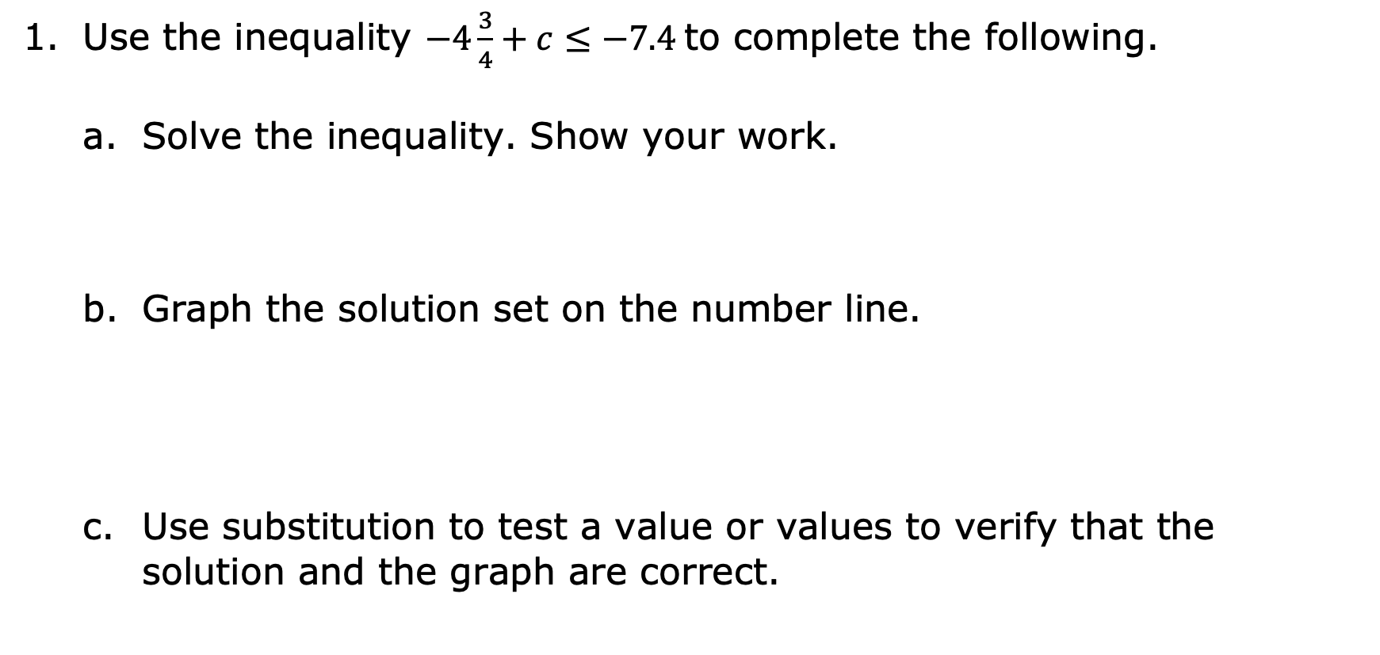
10.2.4 Guided Practice: Solving One-Step Inequalities with Addition and Subtraction
Use the inequality $−4\frac{3}{4}+c≤−7.4$ to complete the following.
Solve the inequality. Show your work.
Graph the solution set on the number line.
Use substitution to test a value or values to verify that the solution and the graph are correct.
volume 2, pg. 95

Slide 21
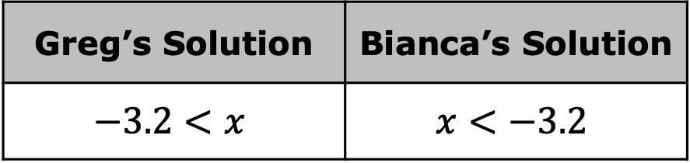

Greg and Bianca both solved the inequality $−5.2+x>−8.4$. Their solutions are shown.
Explain who is correct. Show your work.
Greg’s Solution | Bianca’s Solution
$$−3.2<x$$ | $$x<−3.2$$
volume 2, pg. 96

Slide 22
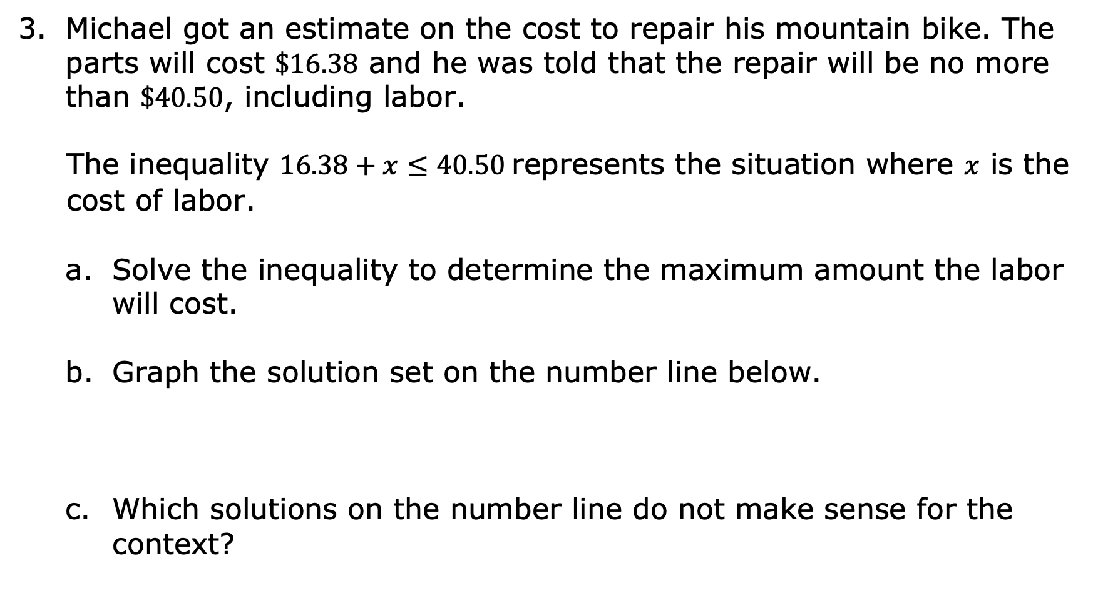
Michael got an estimate on the cost to repair his mountain bike. The parts will cost $\$16.38$ and he was told that the repair will be no more than $\$40.50$, including labor.
The inequality $16.38+x≤40.50$ represents the situation where $x$ is the cost of labor.
Solve the inequality to determine the maximum amount the labor will cost.
Graph the solution set on the number line below.
Which solutions on the number line do not make sense for the context?
volume 2, pg. 96

Slide 23

Your Turn
volume 2, pg. 97

Slide 24
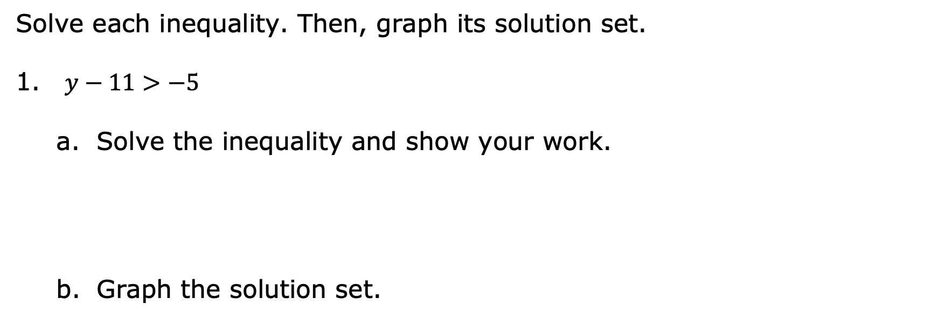
10.2.5 Your Turn!
Solve each inequality. Then, graph its solution set.
$y−11>−5$
Solve the inequality and show your work.
Graph the solution set.
volume 2, pg. 97

Slide 25

$−8\frac{1}{2}≥x+7.25$
Solve the inequality and show your work.
Graph the solution set.
volume 2, pg. 97

Slide 26

Wrap-Up
volume 2, pg. 97

Slide 27
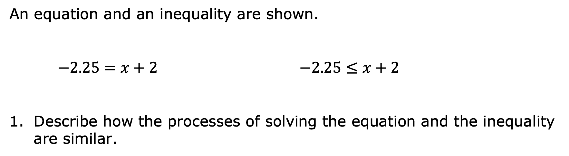
10.2.6 Wrap-Up: Cool Down
An equation and an inequality are shown.
$−2.25=x+2$ $−2.25≤x+2$
Describe how the processes of solving the equation and the inequality are similar.
volume 2, pg. 97

Slide 28
Complete the table to describe how the solutions to the equation and inequality are similar and different.
How are the solutions similar? | How are the solutions different?
volume 2, pg. 97

